Slide 1
How do we prevent avoidable deaths?

Slide 2
autism and anorexia
what do these figures refer to??
2 in 10
2 in 10
9
Notes:
More than 2 in 10 women with anorexia are autistic
Around 2 in 10 people with anorexia will die early
Adults with autism and no additional learning disability are over 9 times more likely (relative to a general population) to commit suicide

Slide 3
autism and anorexia stats Anorexia has the worst outcomes of any mental health condition with 2 in 10 people dying early The mortality risk of people with autism is more than double that of the normal population Adults with autism and no additional learning disability are over 9 times more likely (relative to a general population) to commit suicide More than 2 in 10 women with autism have anorexia
Notes:
Anorexia has the worst outcomes of any mental health condition with 1 in 5 people with dying early, mostly due to starvation or suicide
Emerging research shows that people with either condition have difficulties understanding and interpreting social cues, and tend to fixate on tiny details that make it difficult to see the big picture. What’s more, both groups of people often crave rules, routines and rituals. Genetic studies also suggest overlaps between autism and anorexia.
A lot of the current treatment designed for people with anorexia doesn’t take into account that quite a lot of people also have autism so group sessions or requiring people to rapidly change their eating routine is not so compatible if you have difficulty with social interaction or you need to have sameness.
2 in 10
More than 2 in 10 women with anorexia are autistic
2 in 10
Around 2 in 10 people with anorexia will die early

Slide 4
We need a more holistic approach to accessibility let’s talk about intersectionality
Priyanca

Slide 5
Real people can't descope parts of their lived experience.
The complexity of real lived experiences still exists even if we don't research or design for it.

Slide 6
Can you think of people whose voices and perspectives are often overlooked or erased? People who are rendered invisible.
Can you think of some examples? Why?

Slide 7
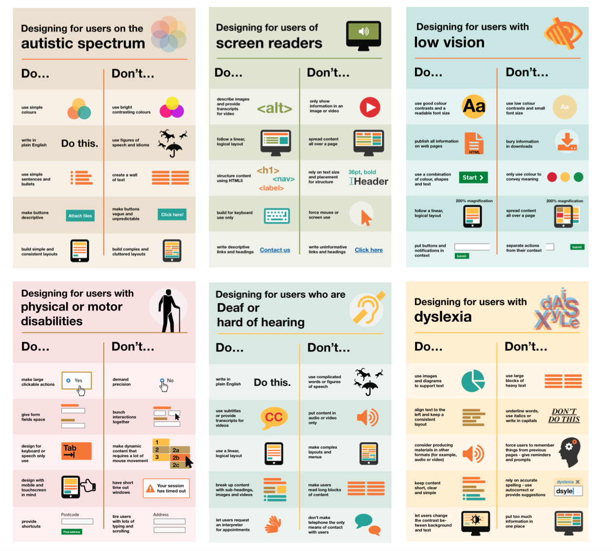
Neatly divided

Slide 8
How do you define yourself? What are the defining parts of your identity? Are there areas where you feel uncertainty about how you define yourself?

Slide 9
Think of circumstances where you have felt left out or like you couldn't fully take part in something. What does it feel like to be excluded?

Slide 10
Accessibility is not something you can automate or should delay until we start building. The interaction between a person and the environment. It's beyond computers.

Slide 11
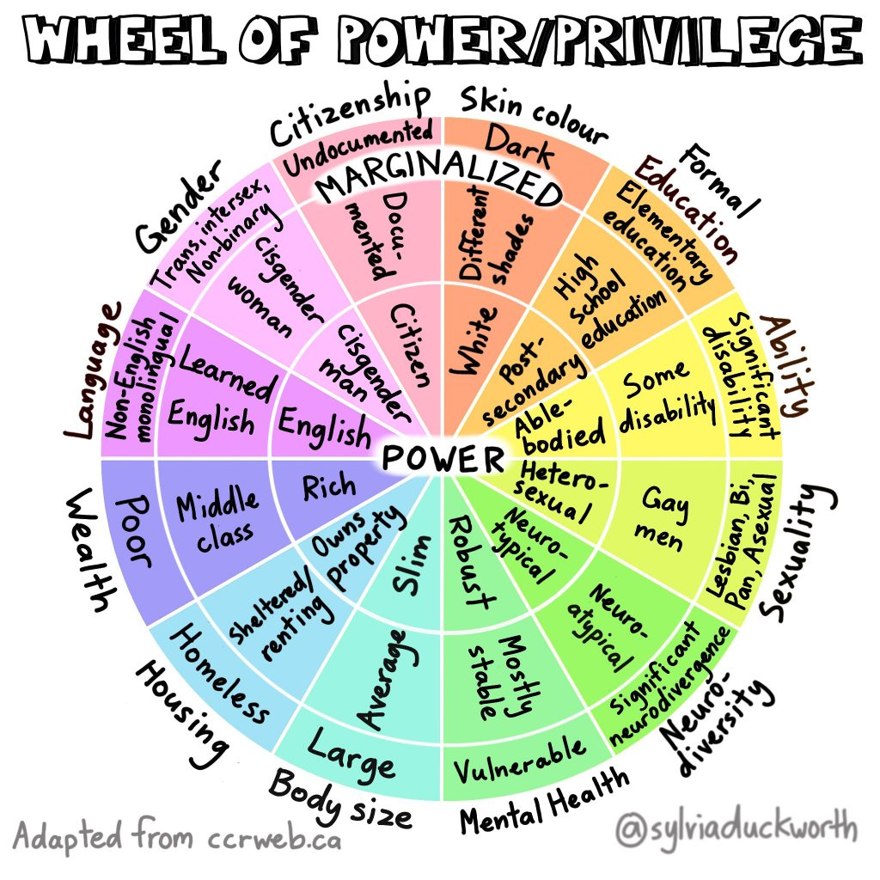
Wheel of Power/Privilege Language Housing Mental health Body size Sexuality Disability Education Skin colour Citizenship Wealth Gender

Slide 12
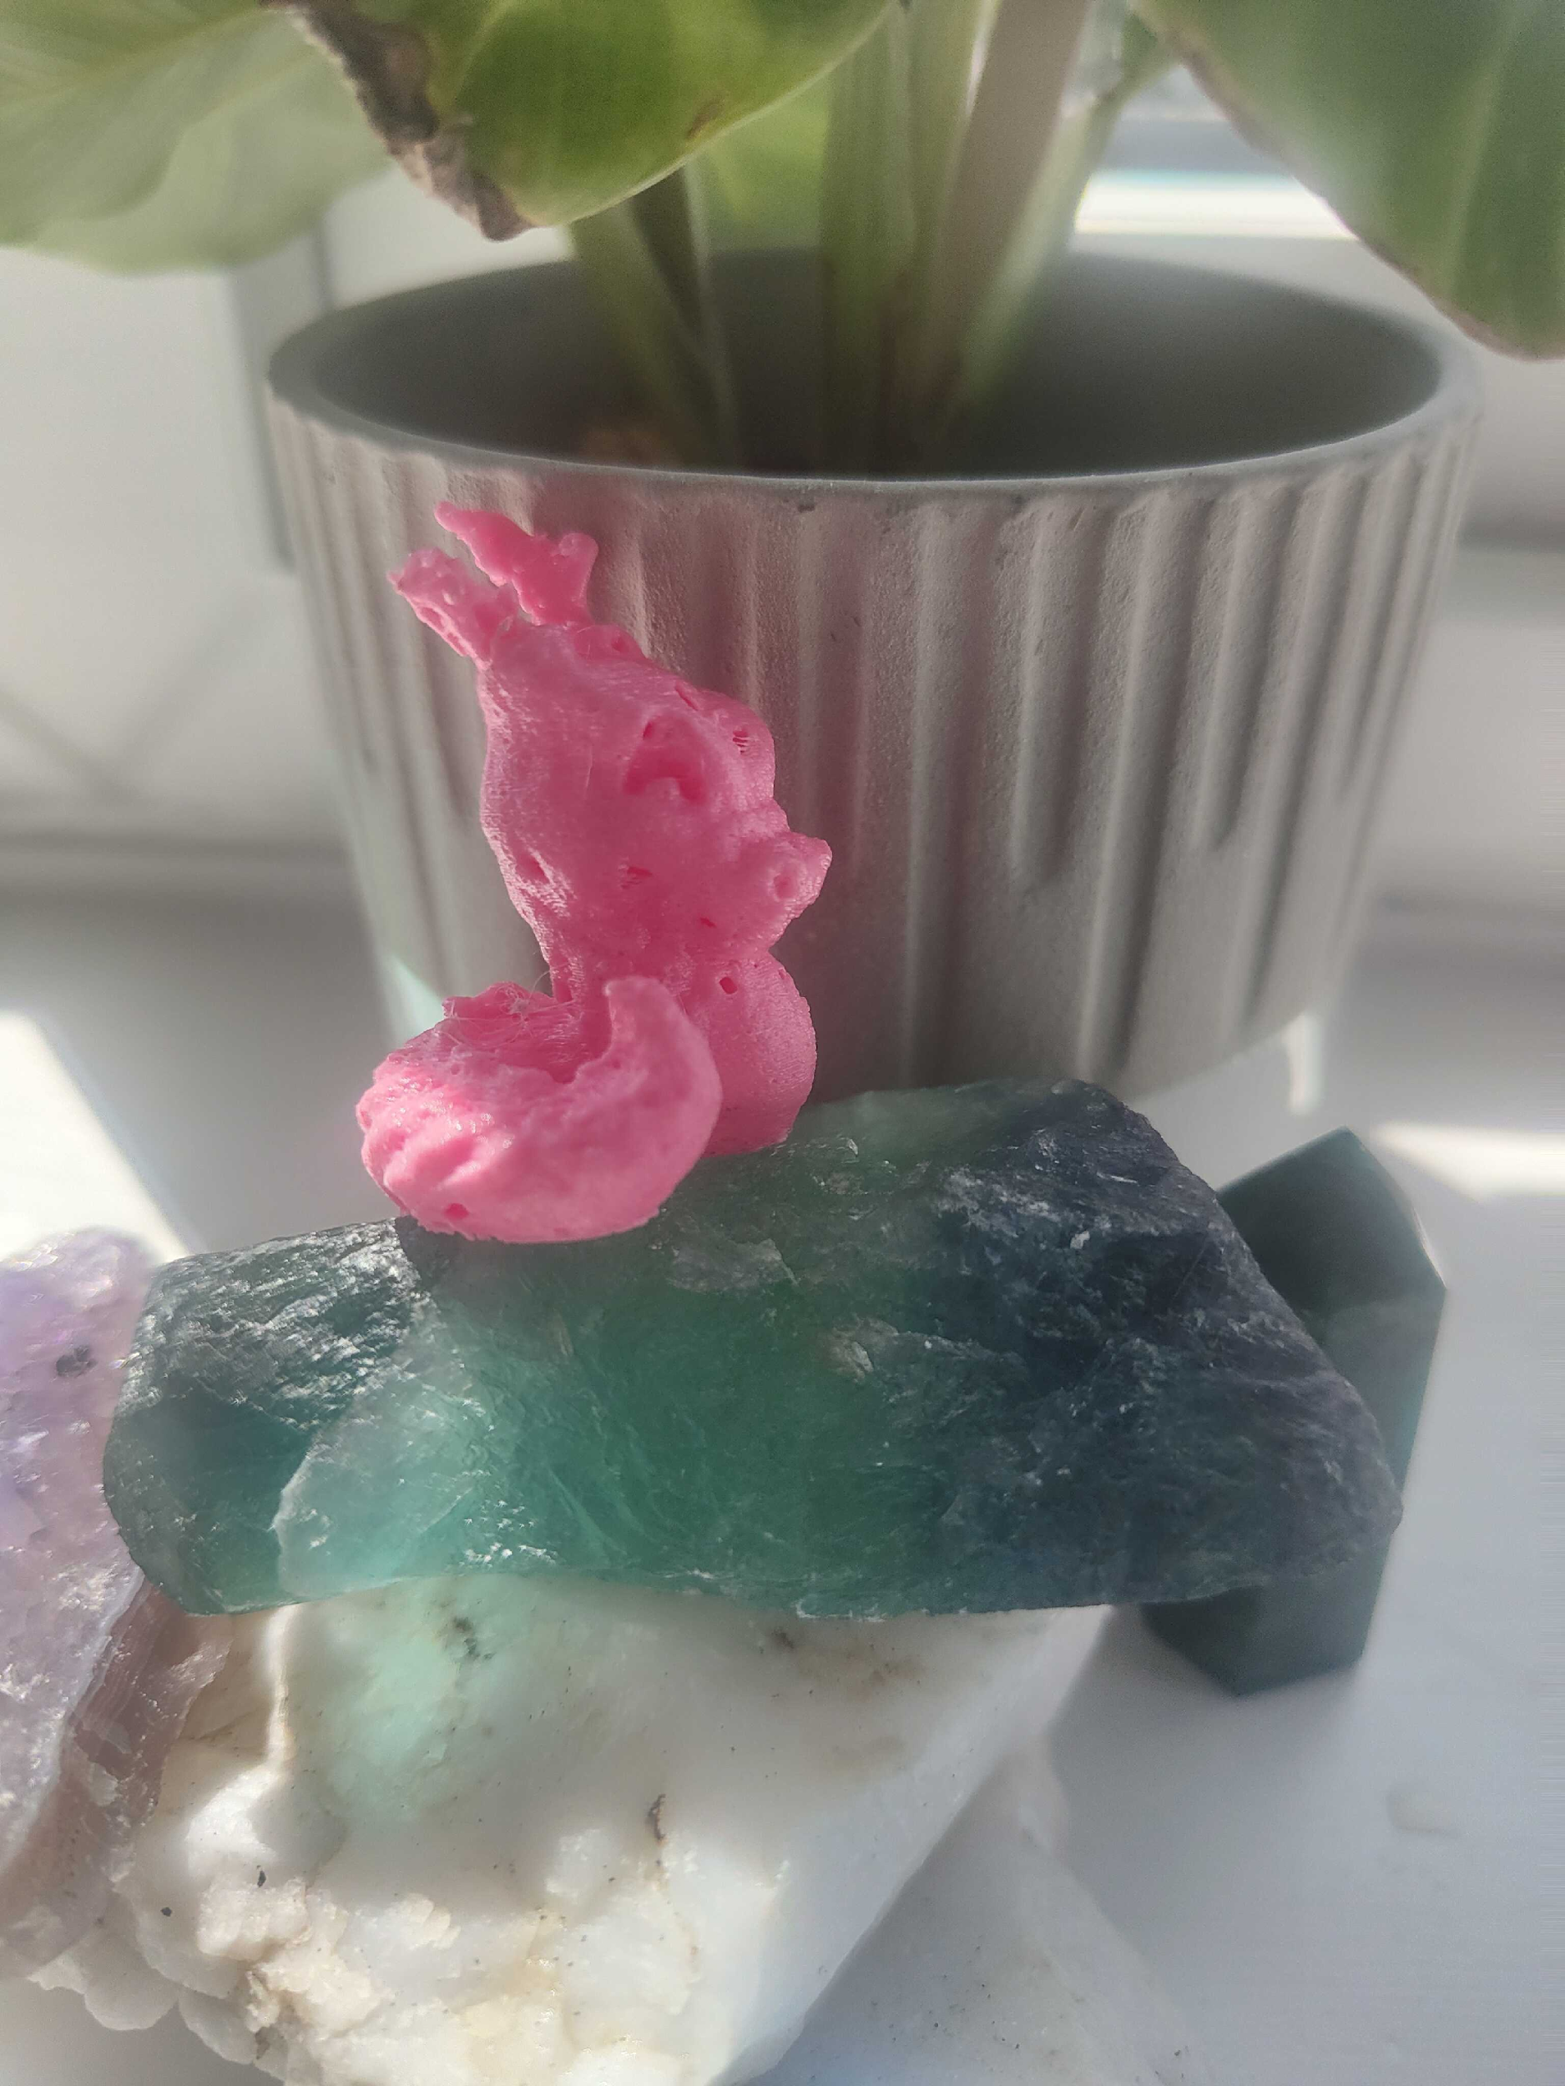
Dragon, naturally speaking?

Slide 13
Heads, shoulders, knees and toes

Slide 14
Pick your favourite barrier

Slide 15
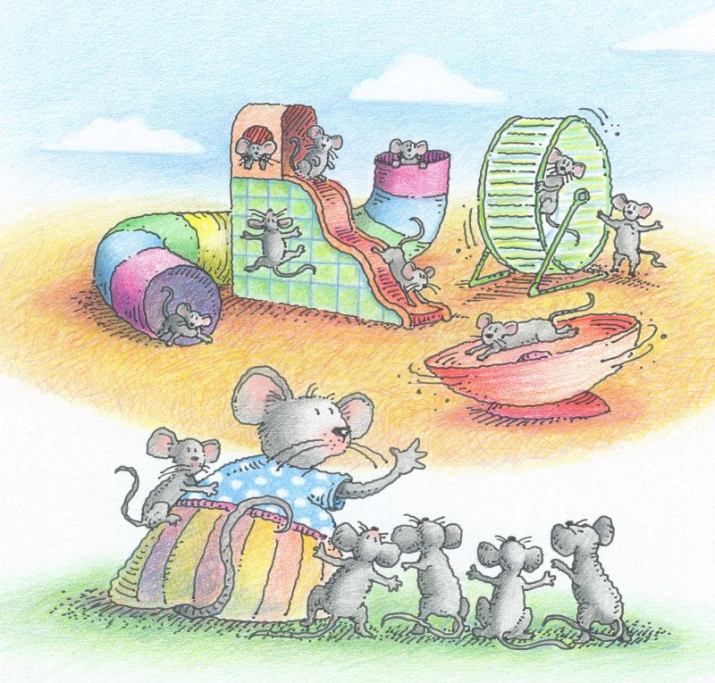
Softer factors
Notes:
Image of an enriched environment

Slide 16
“ Happy families are all alike; every unhappy family is unhappy in its own way.”
Tolstoy, Anna Karenina

Slide 17
Wheel of Power/Privilege Language Housing Mental health Body size Sexuality Disability Education Skin colour Citizenship Wealth Gender

Slide 18
Disabled people in space: better adapted?

Slide 19
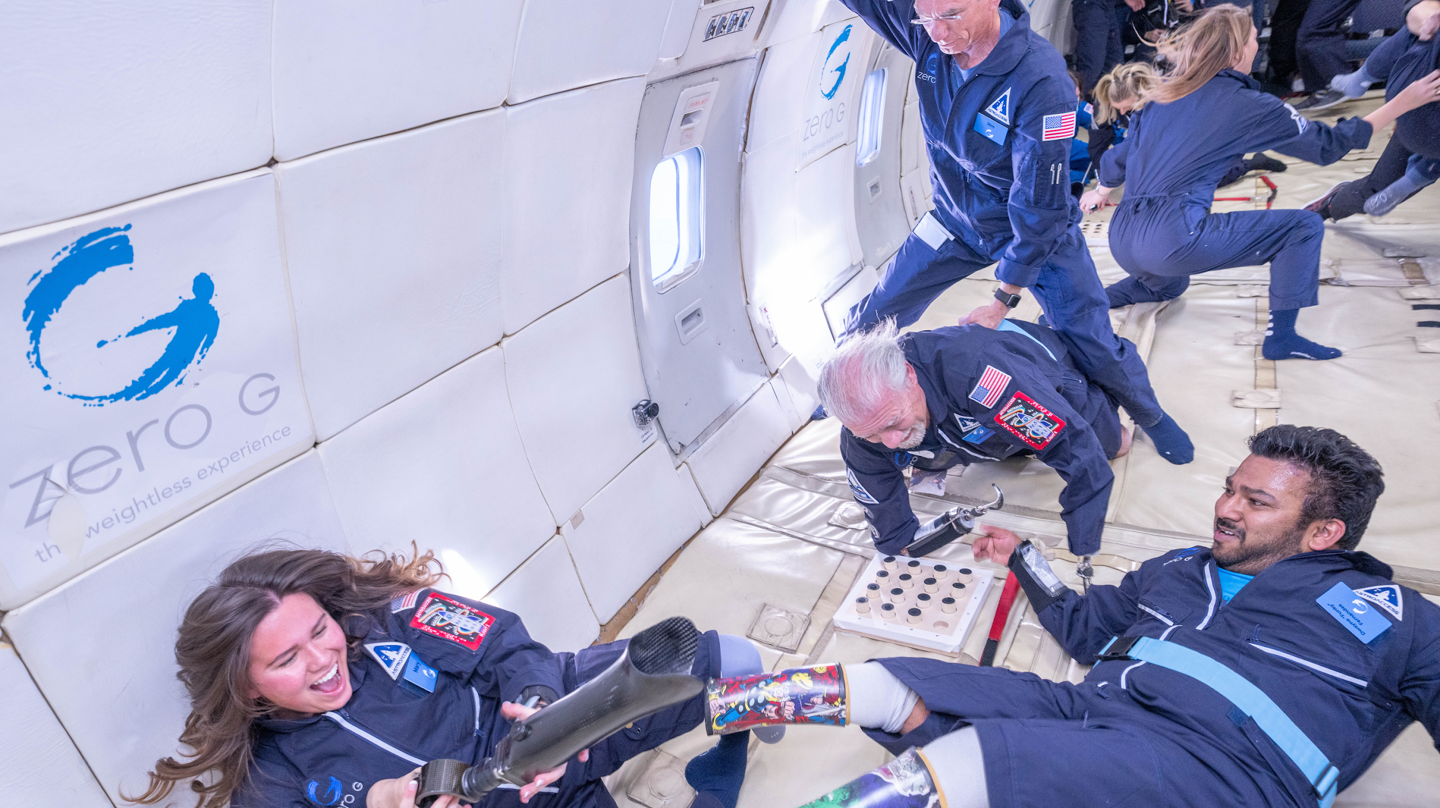
AstroAccess

Slide 20
When in weightlessness, “I am not disabled—I am actually super enabled.” Fernandes described himself as being “compact” and with “upgradeable parts.” Legs “get in the way in space,”

Slide 21
Wheel of Power/Privilege Language Housing Mental health Body size Sexuality Disability Education Skin colour Citizenship Wealth Gender

Slide 22
Real people can't descope parts of their lived experience.
The complexity of real lived experiences still exists even if we don't research or design for it.

Slide 23
Can you think of people whose voices and perspectives are often overlooked or erased? People who are rendered invisible.
Can you think of some examples? Why?

Slide 24
Thank you for listening

