Slide 1
So you pitched for accessibility - and now you’re leading on it
Beverley Newing (they/them)
Accessibility lead at the Ministry of Justice
@webdevbev

Slide 2
Head of Dev at Three Rings CIC
Creator of ‘Record a goose sighting’
Motorbiker, seamsperson, forager

Slide 3
Accessibility lead means different things in different places

Slide 4
Q: Where are you at?

Slide 5
Tips from my PoV:
Front-end dev to leading an accessibility team of 6

Slide 6
It is a really rewarding job - but it is different

Slide 7
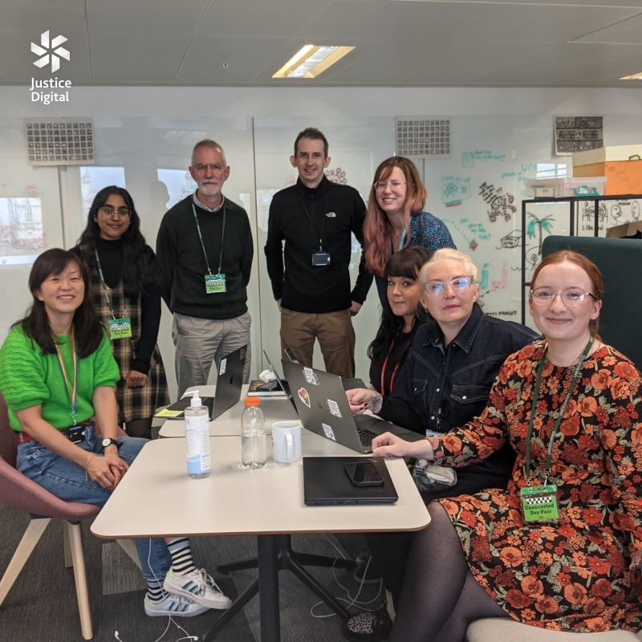
Accessibility at the Ministry of Justice

Slide 8
You don’t have to be a particular personality type to succeed at it

Slide 9
Talk agenda:
Figuring out the bigger picture - 10 mins
Finding your own feet - 10 mins
Leading others - 10 mins
My northern stars - 5 mins
Audience questions - 10 mins

Slide 10
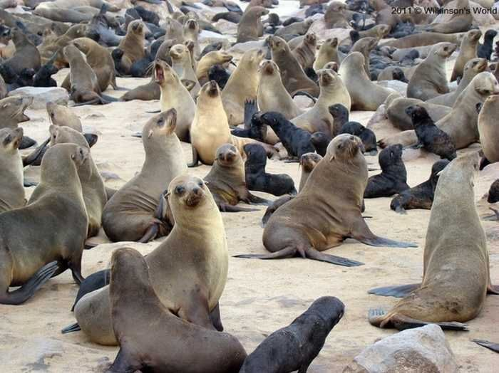
Figuring out the bigger picture

Slide 11
You may no longer be attached to one project

Slide 12
At the start, you might still get pulled into technical tasks

Slide 13
Your job may now include things like:
Contract management
Org-wide accessibility strategy
Line management
Comms and engagement

Slide 14
Start off by proving why you’re needed

Slide 15
Break it down into chunks

Slide 16
Figure out who you need to engage with - and how

Slide 17
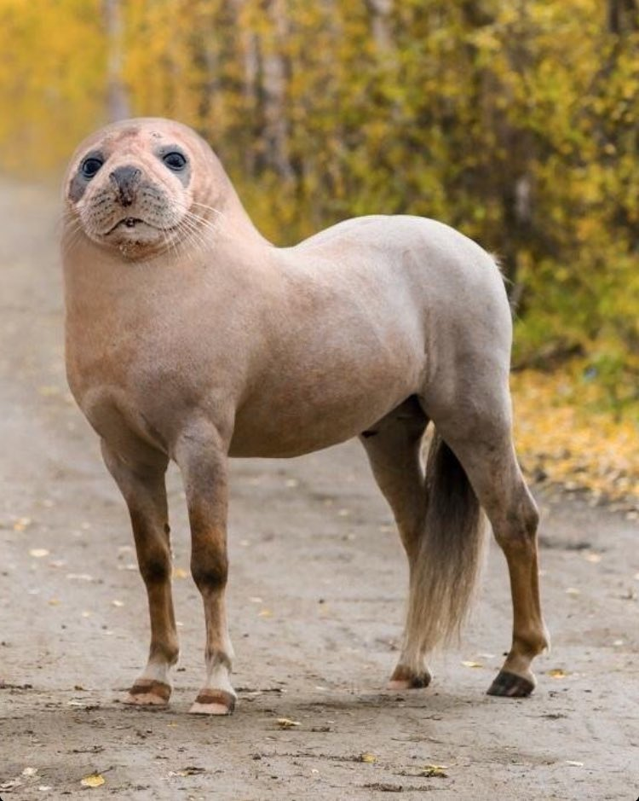
Don’t become the PR pony

Slide 18
Accessibility is a team sport

Slide 19
Create a culture of shared responsibility - or risk burnout

Slide 20
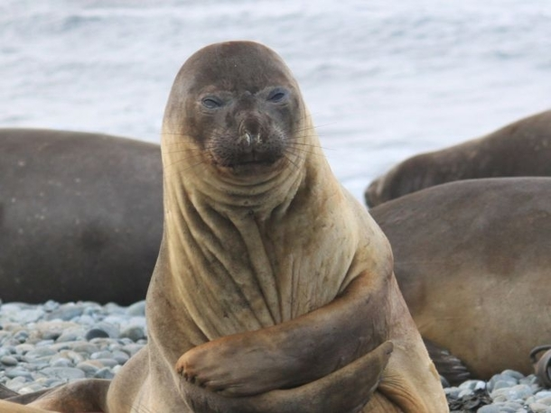
Finding your feet

Slide 21
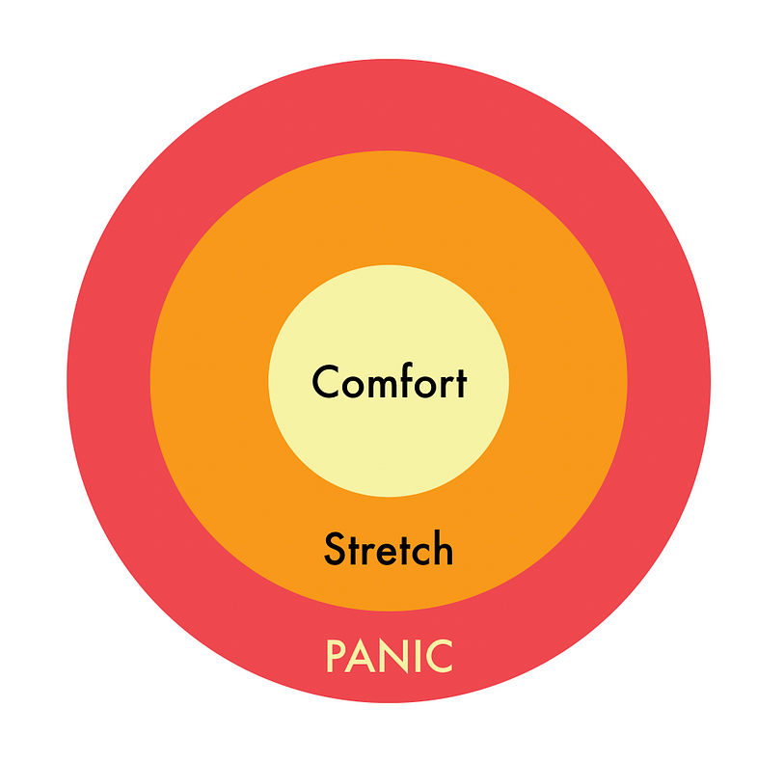
Comfort vs stretch vs panic zone
@tara_ojo

Slide 22
Some of that might not be in your current skill set

Slide 23
You are now your own boss *

Slide 24
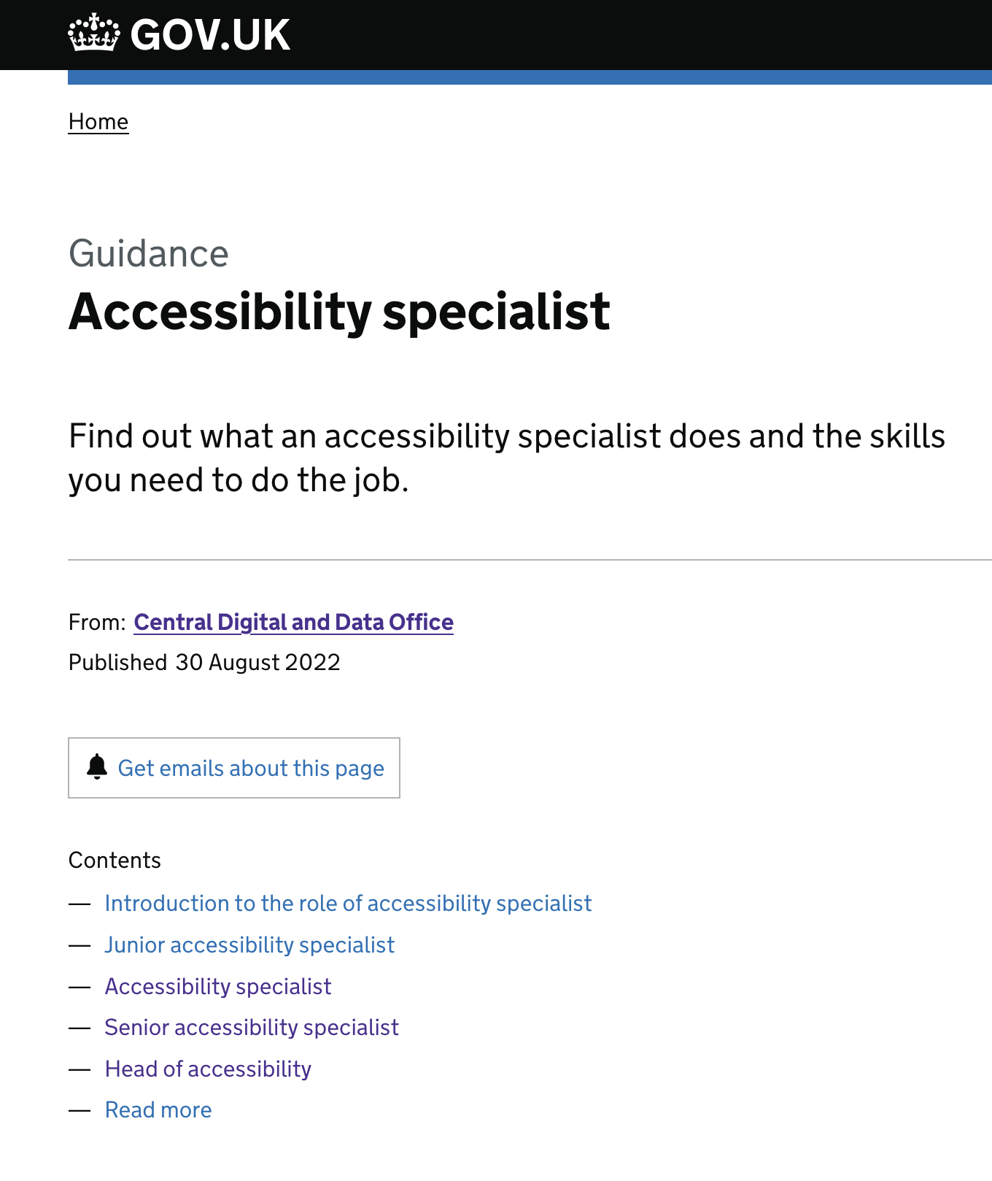
The DDaT framework might help

Slide 25
Create a learning plan

Slide 26
Find your mentors (plural)

Slide 27
Find the hacks that help you work

Slide 28
Be open to new techniques

Slide 29
Imposter syndrome is Real

Slide 30
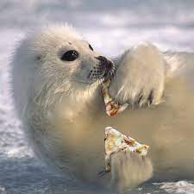
Support and champion yourself

Slide 31
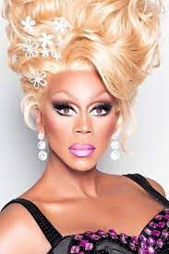
“If you can’t love yourself, how are you gonna love anyone else?”

Slide 32
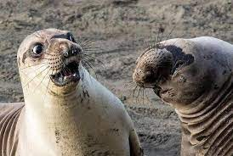
Leading others

Slide 33
Making sure your bad day doesn’t become someone else’s

Slide 34
Q: Who here has had a difficult accessibility interaction?

Slide 35
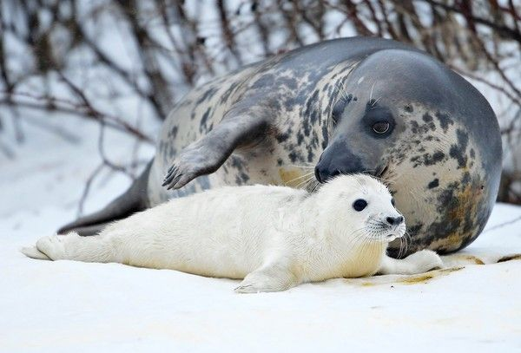
We sometimes have to call people’s babies ugly

Slide 36
Helping people through the valley of despair

Slide 37
Boundaries are your friend

Slide 38
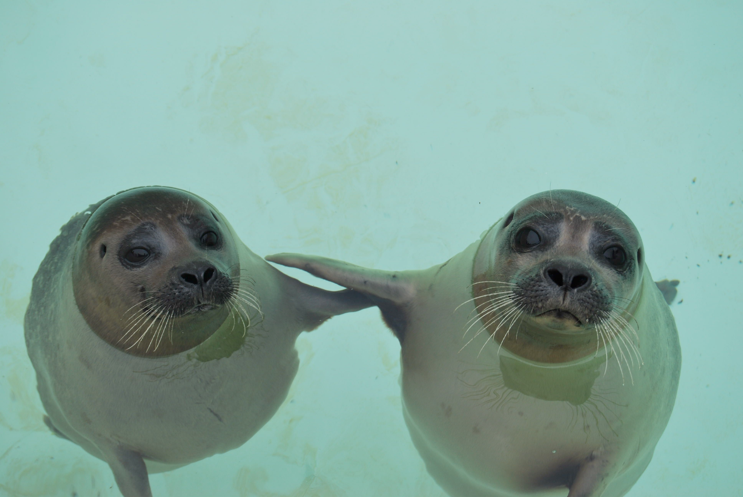
Find your friends and (new) peers

Slide 39
Why are you in the meeting?

Slide 40
Who’s back is the monkey on?

Slide 41
What would you change if you could do it all over again?

Slide 42
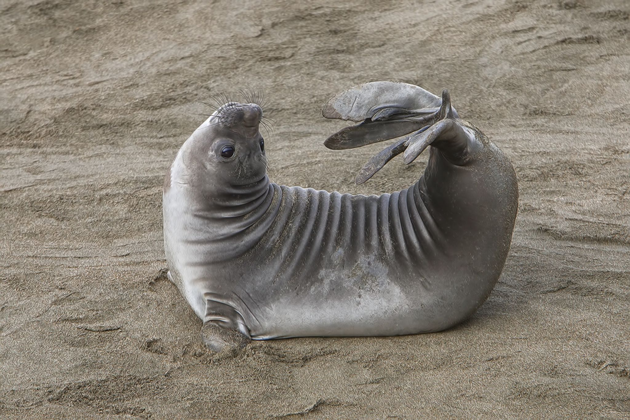
My northern stars

Slide 43
It’s a marathon, not a sprint

Slide 44
Be pragmatic - pick your battles

Slide 45
Find your technical serotonin source(s)

Slide 46
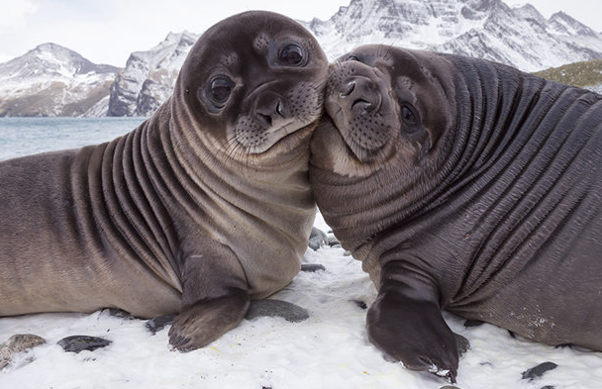
Be kind

Slide 47
Q: who now feels more confident about lead roles?

Slide 48
Audience questions?
Beverley Newing
Accessibility lead at the Ministry of Justice
@webdevbev

