Slide 1
Stress and trauma:
designing content that helps
Rachel Edwards
Senior Content Designer

Slide 2
Topics covered include (in order):
hospital appointments,
Scotland’s Redress Scheme (for survivors of abuse in care),
funeral planning,
FGM.
✘ Won’t talk about:
details of individual’s experiences.
✔ Will talk about:
examples from my work,
some of the issues that came up.

Slide 3
Can I ask you a question?
(or 2…)

Slide 4
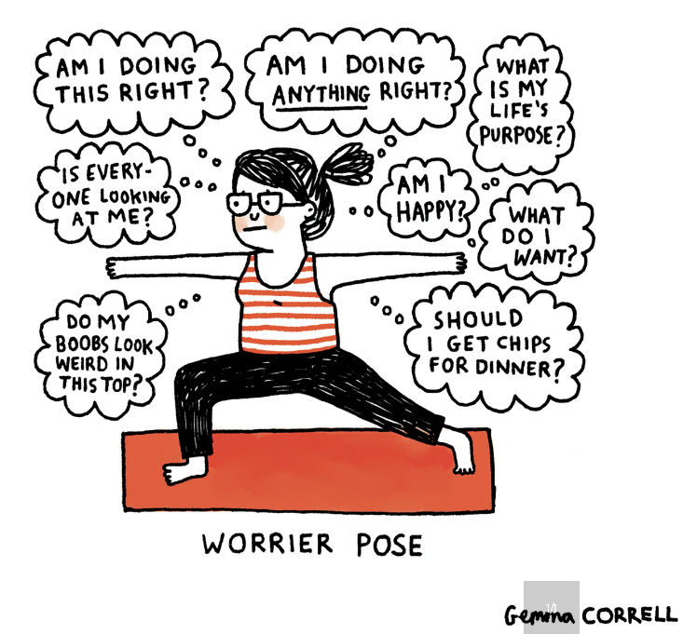

Slide 5
Stress
usually happens because of an external cause,
we can usually say what is causing the stress,
when that thing goes away so does the stress.

Slide 7
Anxiety
internal reaction to stress,
can continue after the stressful situation has passed,
may include anxiety about the stress or anxiety itself.

Slide 9
Trauma
can result from very stressful, frightening or distressing events,
can happen to anyone, at any age,
can have long-term effects.

Slide 11
You don’t have to decide which one someone is experiencing.
The principles apply equally to people in any of these 3 categories.

Slide 12
You never know what the person coming across your content is going through.

Slide 14
No matter who we are, stress hormones can make it harder to:
read,
understand information,
make decisions,
consider and reflect on information.

Slide 15
“When we are stressed or highly anxious the hormones that the body produces, particularly cortisol, divert essential resources from the brain to the large muscles in the body in preparation for fight and flight.
…humans can also trigger this stress reaction by simply thinking about or remembering the stressful situation.”
British Dyslexia Association

Slide 16
32% of adults struggled to make basic decisions,
such as what to wear or what to eat.
American Psychological Association

Slide 17
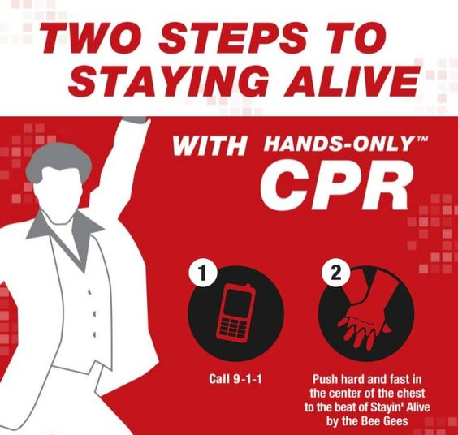

Slide 18
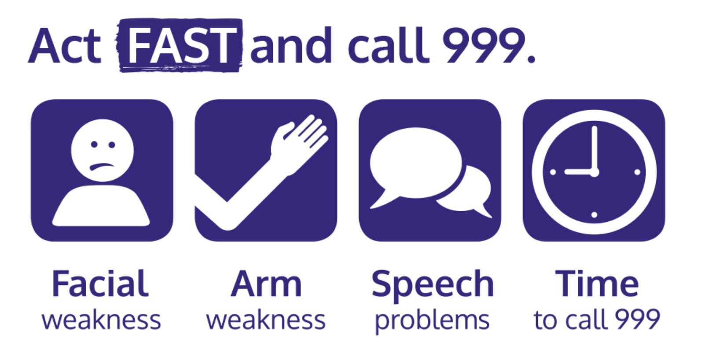

Slide 19
Scottish Government
trauma-informed practice toolkit
user behaviours considered as potential responses to trauma,
organisation works to prioritise building “trusting, mutual relationships above all else.”

Slide 20
The 4 Rs
A program, organisation, or system that is trauma-informed:
realises the impact of trauma and understands potential paths for recovery,
recognises the signs and symptoms of trauma,
responds by integrating knowledge about trauma into practices,
resists re-traumatisation.
American Substance Abuse and Mental Health Services Administration

Slide 21
Re-traumatisation
reaction to a new event that feel as intense as the original event,
can include feeling like the trauma is happening right now,
can have intense, unpleasant physical sensations.

Slide 22
Scotland’s
Redress
Scheme

Slide 23
People who have been in care are “more likely than the general population to:
be unemployed,
have mental health problems,
spend time in prison or psychiatric institutions, or
experience homelessness at some point in their lives.”
“What is the relationship between being in care and the educational outcomes of children?” - Rees Centre for Research in Fostering and Education, 2015

Slide 24
Trauma informed principles
safety,
trust,
choice,
empowerment,
collaboration,
cultural, historical and gender issues.

Slide 25
Safety
Avoid causing further harm (re-traumatising).

Slide 26
“Exit this page fast with the Design System’s new component”
Search: “gov.uk blogs” “exit this page”

Slide 27
This could include help with questions about providing documents. If you want help before sending in the form, you can:
read page 13 of the “Help to apply” guidance
contact a case worker
The next section is for applicants with a terminal illness. If you do not have a terminal illness, go to Section 5.
Do you want help with this section?

Slide 28
Trust
Don’t be:
inaccurate,
hard to find,
unclear,
not in your user’s voice,
unnecessary.

Slide 29
If you ask for information, first ask yourself why.
Can you:
do without the information?
say why you need it?
remove any questions?
get the information another way?

Slide 30
Choice
If possible and practical, give people meaningful choice.

Slide 31
This is not a meaningful choice:
If you are not comfortable with a male examiner, you can request a female.
Please keep in mind this may delay your appointment.
(or)
This may not always be possible.

Slide 32
Empowerment
Clear, accessible content can support someone to:
act independently,
make their own decisions,
learn something new.

Slide 33
Collaboration
When you’re creating content for people who have experienced trauma, collaboration is even more important.

Slide 34
When I was (age) ,
in (date) ,
in (place) ,
_______________________________
_______________ happened to me.

Slide 35
You need to provide a statement about your abuse.
It is up to you how much information you want to include. As a minimum you need to provide information about:
where you were living when the abuse happened,
when the abuse happened,
what happened
You do not have to write a lot, unless you want to.

Slide 36
Cultural, historical and gender issues
Consider things like:
values,
language,
belief,
customs.

Slide 38
Please provide your details
Q1 I First name
Q2 I Last name
Q3 I Date of birth
Day Month Year
In some cases your name or date of birth may have changed or be unclear.
Please give the name and date of birth you regularly use for official documents.

Slide 39
don’t assume,
test wherever you can,
everyone experiences trauma differently,
use content to empower.

Slide 40
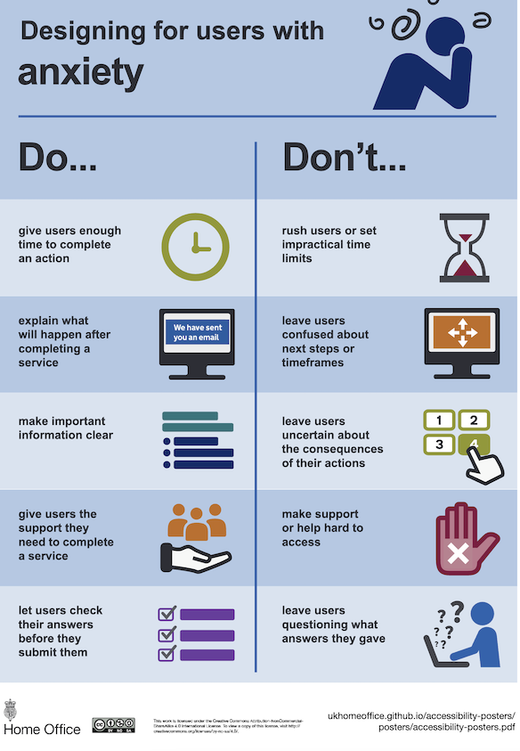
search: Accessibility posters - designing for anxiety

Slide 41
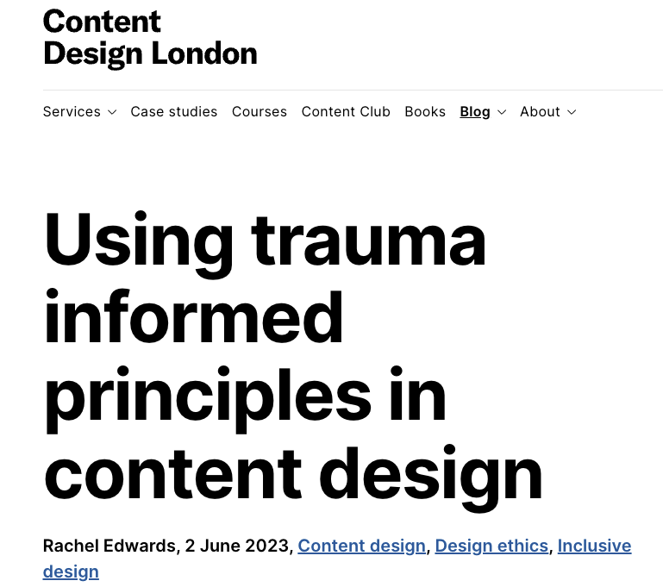
search: “trauma informed content design” + “Content Design London”

Slide 42
Connect
rachel.edwards@contentdesign.london
LinkedIn: Rachel-Edwards-Scotland
Questions?

