Slide 1
Blank

Slide 2
Accessibility and Autonomy in Cultural Attractions

Slide 3
Holding a place for imagination and independence

Slide 4
Lots of maps and diagrams

Slide 5
Going from…

Slide 6
…and Accessibility

Slide 7
The afterthought

Slide 8
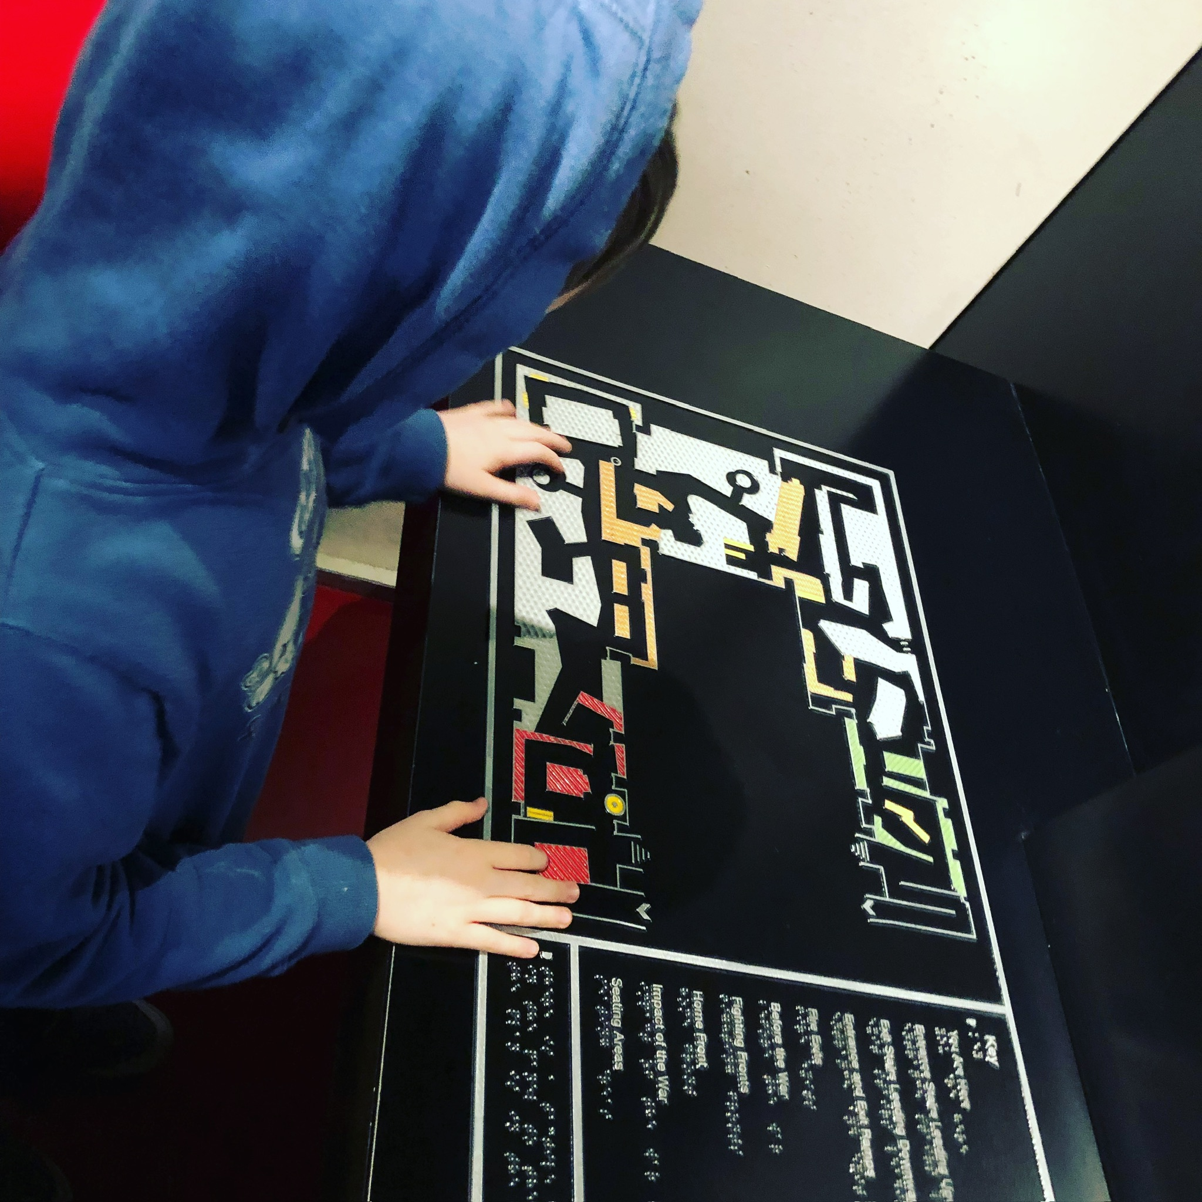
IWM tactile map image

Slide 9
To…

Slide 10
Accessibility and…

Slide 11
Accessibility is the whole design space

Slide 12
Usability is within Accessibility

Slide 13
Perception seeks Usability

Slide 14
Usability seeks Intention

Slide 15
A model*
*All models are wrong, some are useful
George Box

Slide 16
Intention
Imagination
Simulation
Standards
Prediction
Interaction

Slide 17
The biased assumptions of: direct intention frictionless interaction

Slide 18
There is something hiding behind this

Slide 19
Let us start

Slide 20
Information Architecture Service Design Content Design

Slide 21
Accessibility and…

Slide 22
Information Architecture

Slide 23
Wayfinding, maps, symbols, metaphors and so on

Slide 24
One map, one metaphor is not enough

Slide 25
The Before The During

Slide 26
Movement changes meaning

Slide 27
AB

Slide 28
CD

Slide 29
Misorientation Disorientation

Slide 30
Let people stop and go back

Slide 31
Accessibility and…

Slide 32
Service Design

Slide 33
User Journey

Slide 34
User Journey
There and back again
Swim lanes

Slide 35
Anxiety about going and coming back

Slide 36
Clifford’s Tower

Slide 37
3 parts of York Clifford Tower interpretation pack
Notes:
The journey starts at home

Slide 38
Close up of metal map at Clifford's Tower

Slide 39
Support swim lanes of perception

Slide 40
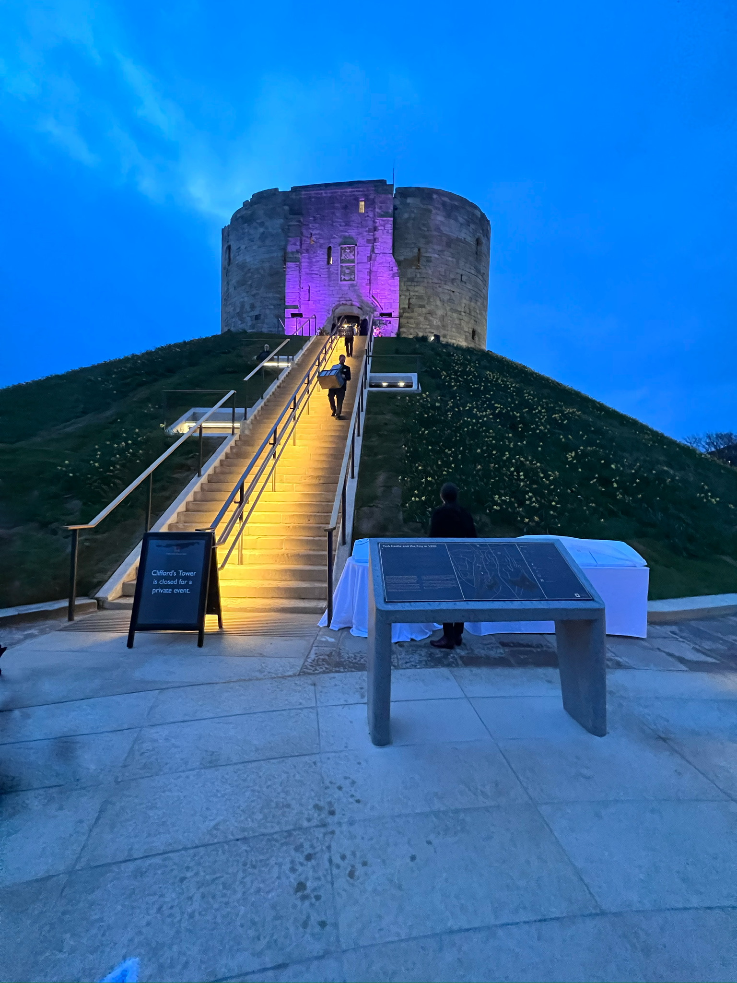
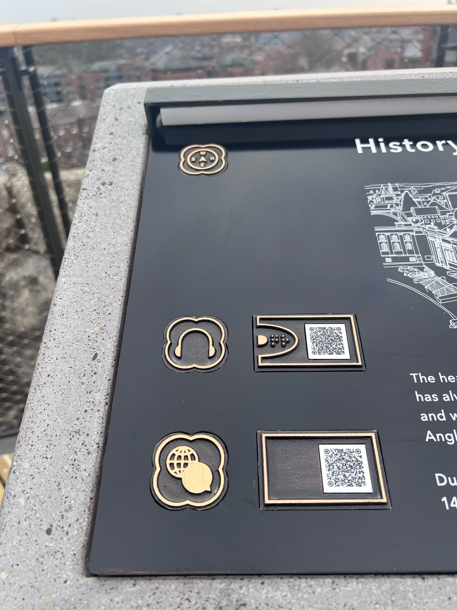
2 pictures on site at Clifford’s Tower

Slide 41
Accessibility and…

Slide 42
Content Design

Slide 43
Chunking

Slide 44
Chunking Tools
Question marking?
Minimum Viable Storytelling

Slide 45
Housesteads

Slide 46
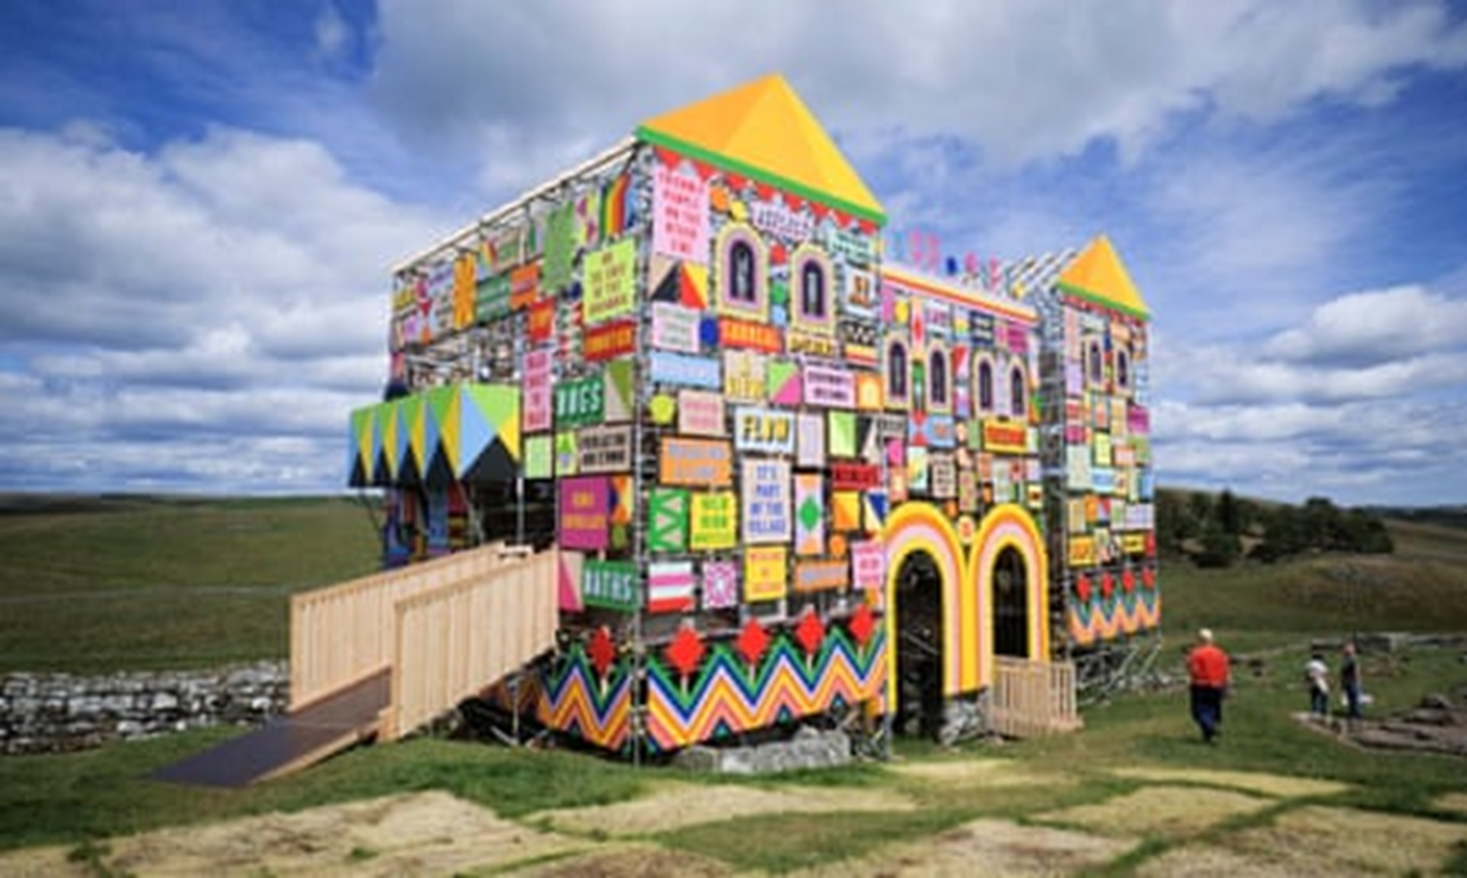
Housesteads art installation

Slide 47
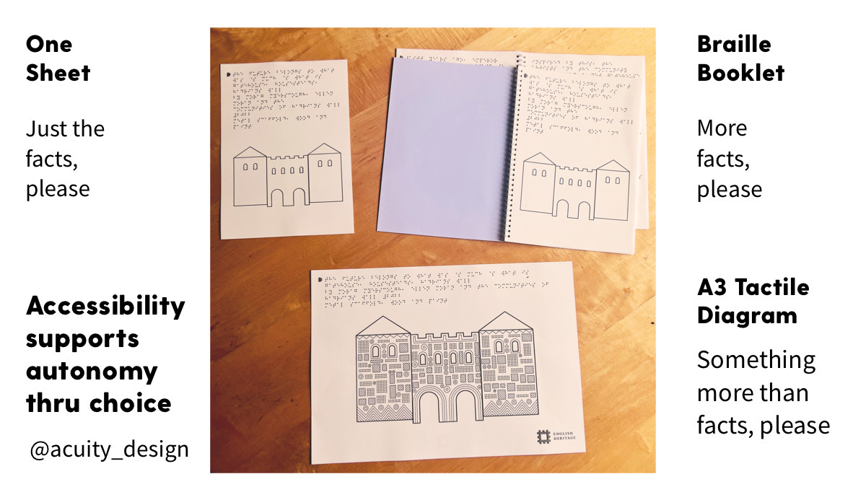
3 parts of Housesteads interpretation

Slide 49
BUT…

Slide 50
The Convergence trap

Slide 51
Intention
Imagination
Simulation
Standards
Prediction
Interaction

Slide 52
The biased assumptions of: direct intention frictionless interaction

Slide 53
The hidden things

Slide 54
Control, compliance and consumerism

Slide 55
Accessibility and…

Slide 56
Autonomy

Slide 57
Independence Divergence

Slide 58
Privilege
Agency
Autonomy
Standards
Independence

Slide 59
Accessibility and…

Slide 60
Losing control

Slide 61
Belsay Hall

Slide 62
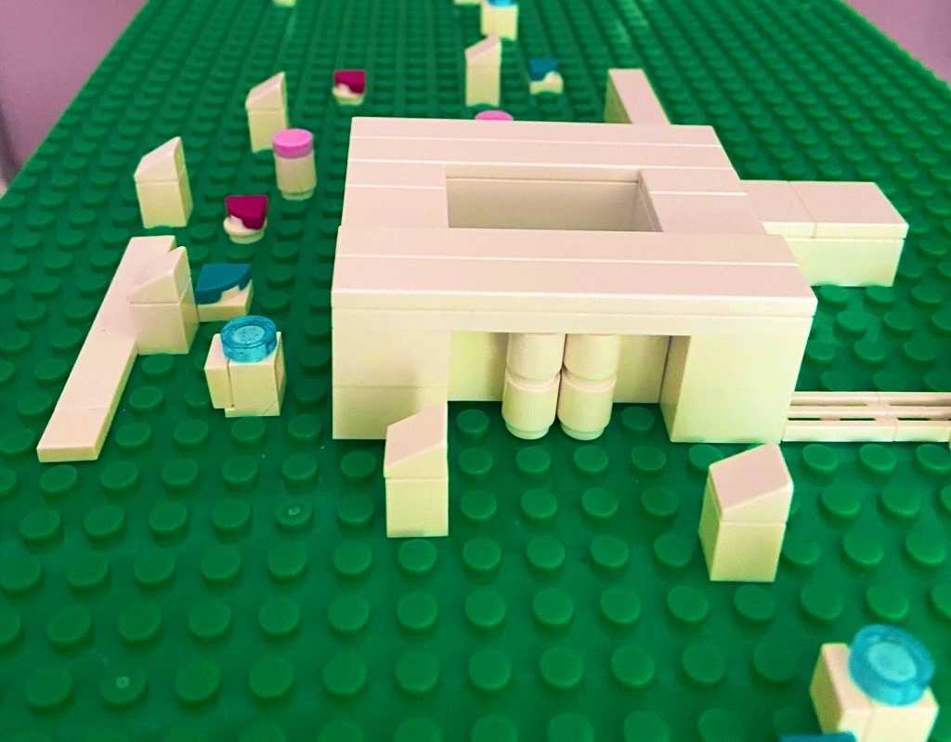
Lego model of Belsay Hall

Slide 63
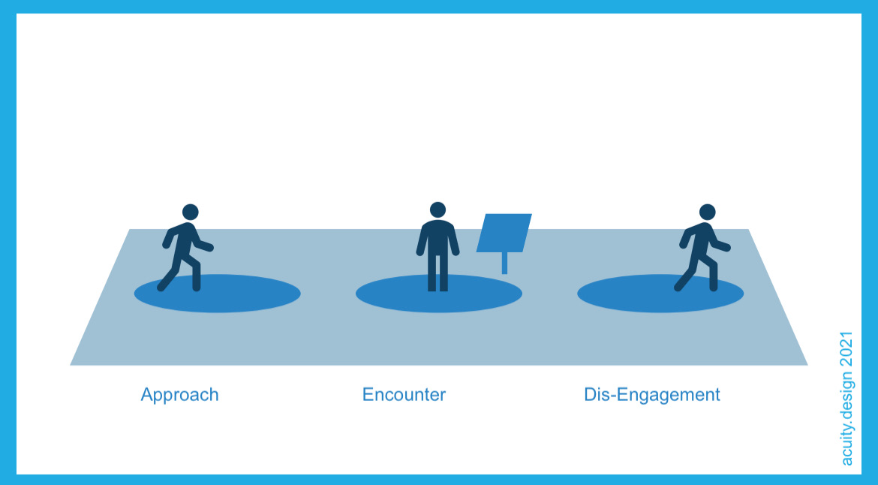
Approach encounter disengage diagram

Slide 64
Highlighted diagram

Slide 65
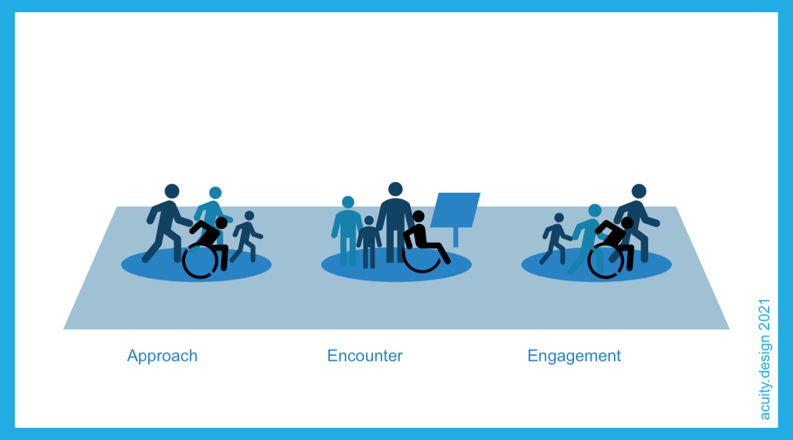
Engagement post content diagram

Slide 66
Highlighted diagram

Slide 67
Leaving the place

Slide 68
Diversity as essential

Slide 69
AltText and bias

Slide 70
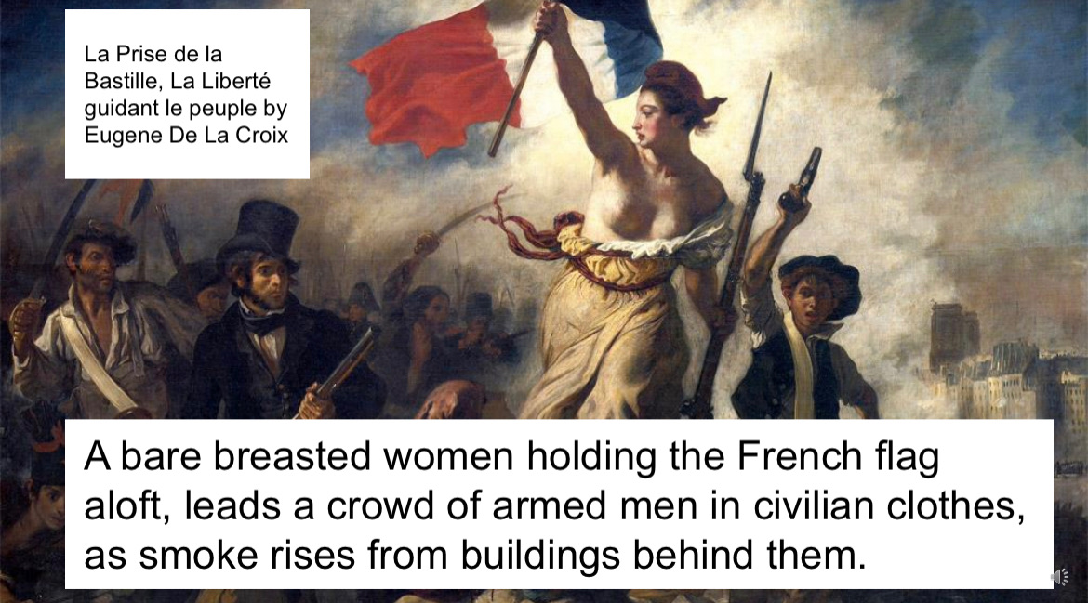
Fall of Bastille

Slide 71
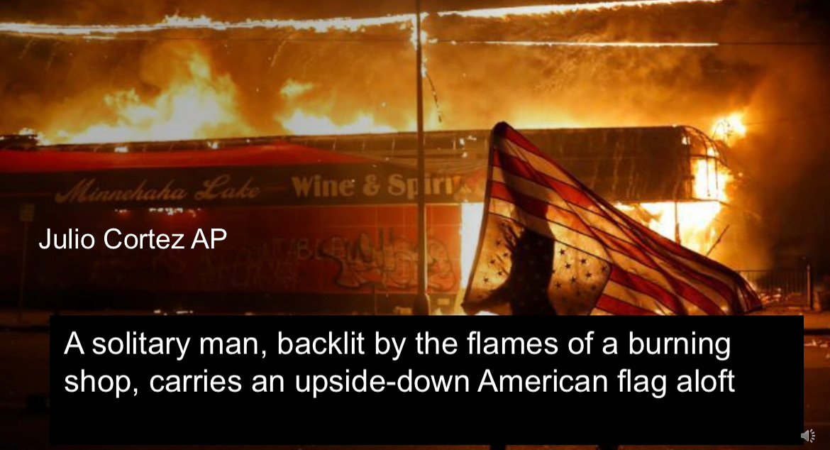
Urban violence

Slide 72
Explicit action and direct support

Slide 73
The NEO Collections project
Nutzerzentriert (user-centred) Explorativ (explorative) Open – Digital museum’s collections in the 21st century

Slide 74
You need our eyes to see us

Slide 75
Accessibility and…

Slide 76
Imagination

Slide 77
Privilege
Agency
Autonomy
Standards
Independence
Imagination

Slide 78
Climate
Crisis

Slide 79
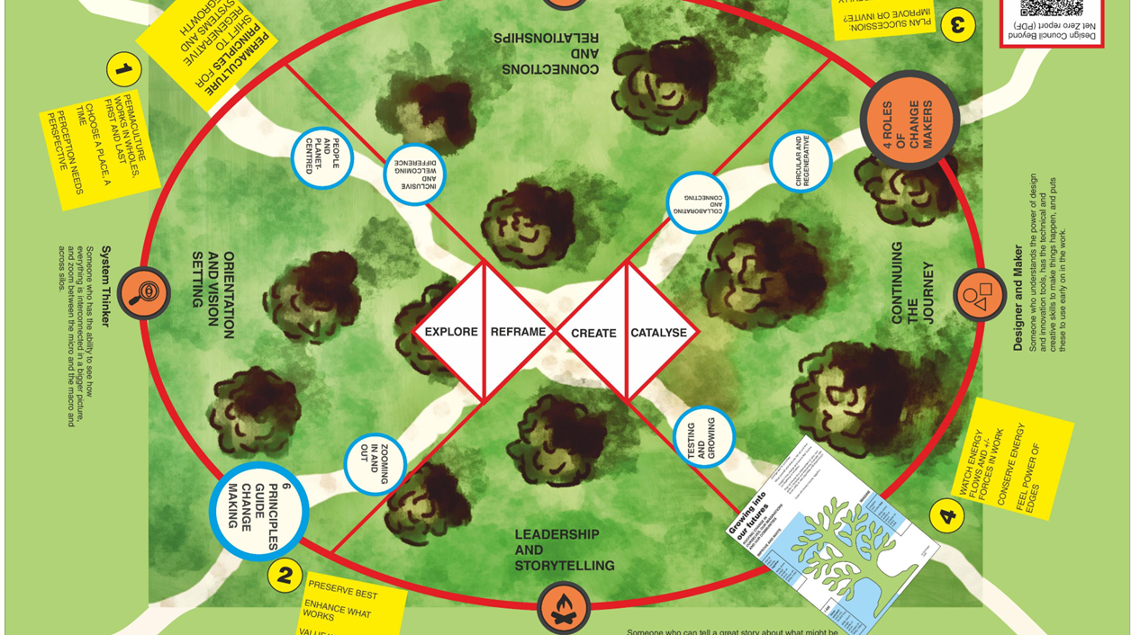
Map of systemic design theory

Slide 80
Communal imagination and shared hope

Slide 81
Accessibility and…

Slide 82
…more

Slide 83
Blank

